Slide 1

G.N.I 1926 Corp
PROFESSIONAL PLUMBING AND WELDING SERVICES

Slide 2

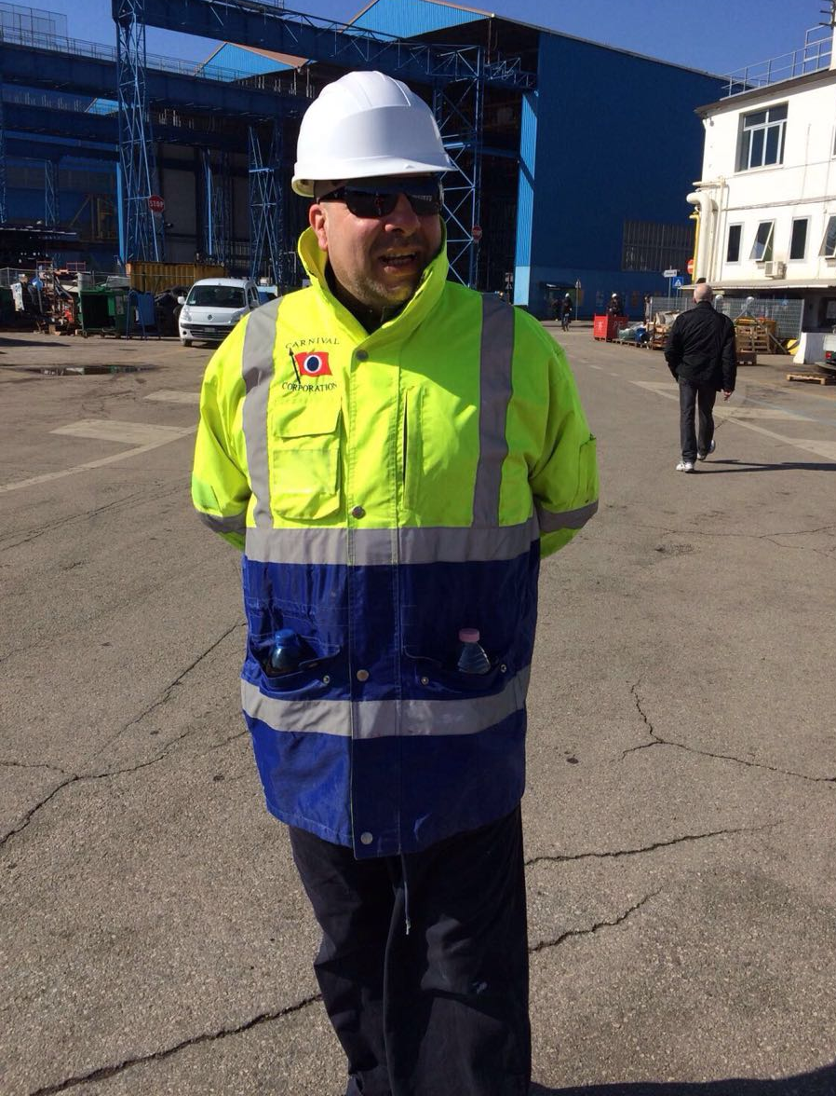
ABOUT US
G.N.I 1926 is a family owned business, that provides professional plumbing and welding services both during dry dock and on seagoing ships.
The company was founded in 2018 by a former Chief plumber Nunzio Infante.
Mr. Infante has more than 25 years of professional experience with the biggest cruise lines, like Carnival Cruise line, MSC Crociere, Costa Crociere.
As well as 15 years of experience at the shipyards, on position of CCS Inspector/ Chief plumber during the construction of 15 Carnival ships in Italy.

Slide 3
OUR WORK
G.N.I 1926 provides a wide range of plumbing and welding services on board, such as
maintenance of:
Grey and black water system,
AC drain pipe,
Window washing system,
Hot/cold and fresh water system,
Hot/cold water and technical water recirculation systems,

Slide 4
OUR WORK
Installation of GF piping system

Slide 5
OUR WORK
Replacement of the Cunipress Savinox black water system to GF fuseal PP system
Replacement of the Coes Blue power grey water system to GF piping in all the galley’s drain

Slide 6
OUR WORK
maintenance of all of the vacuum breakers,
refrigerant line insulation,
hot and cold water pipe insulation,
maintenance of the fire system,
construction of the hot/cold water emergency line in the engine room

Slide 7
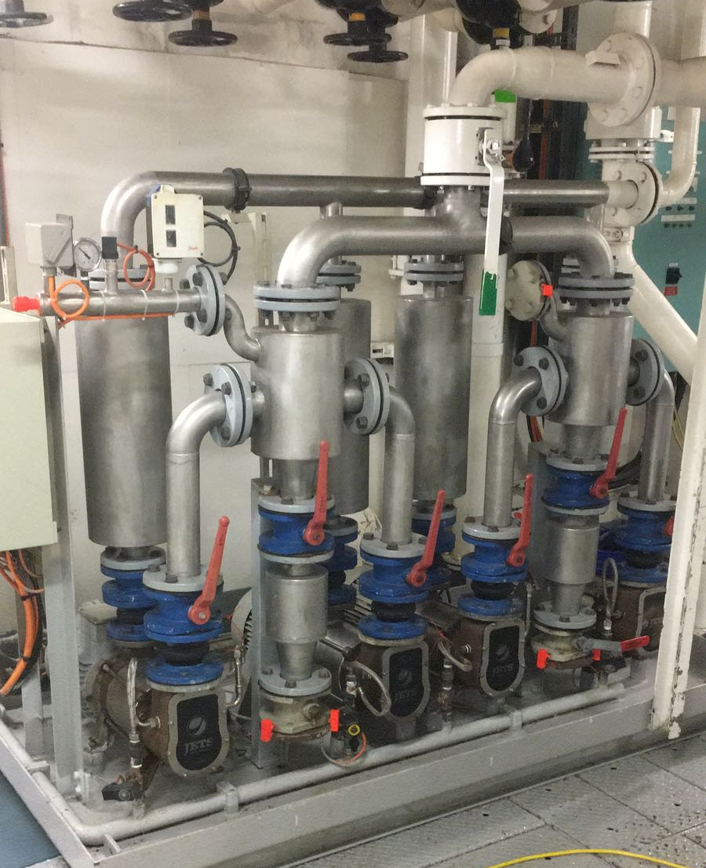
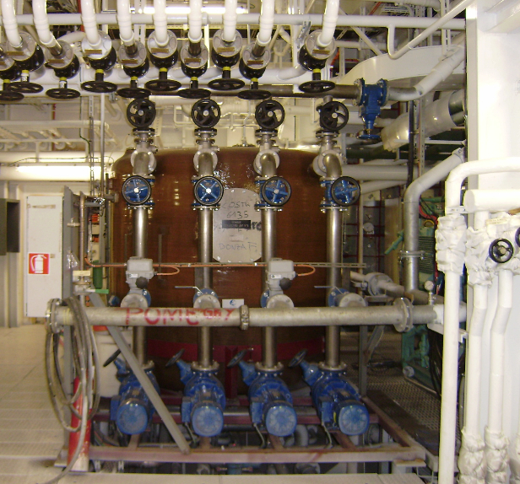
OUR WORK
Replacement of the Evac vacuum toilet system to Jets vacuum toilet system

Slide 8
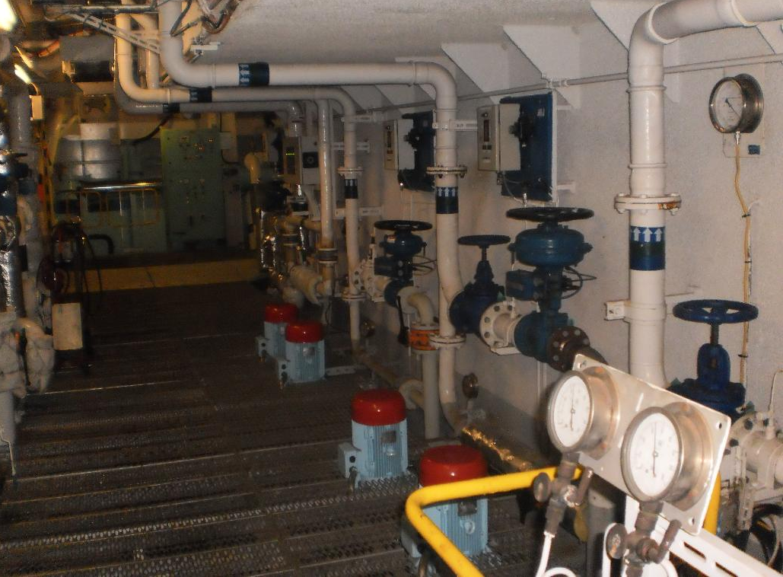
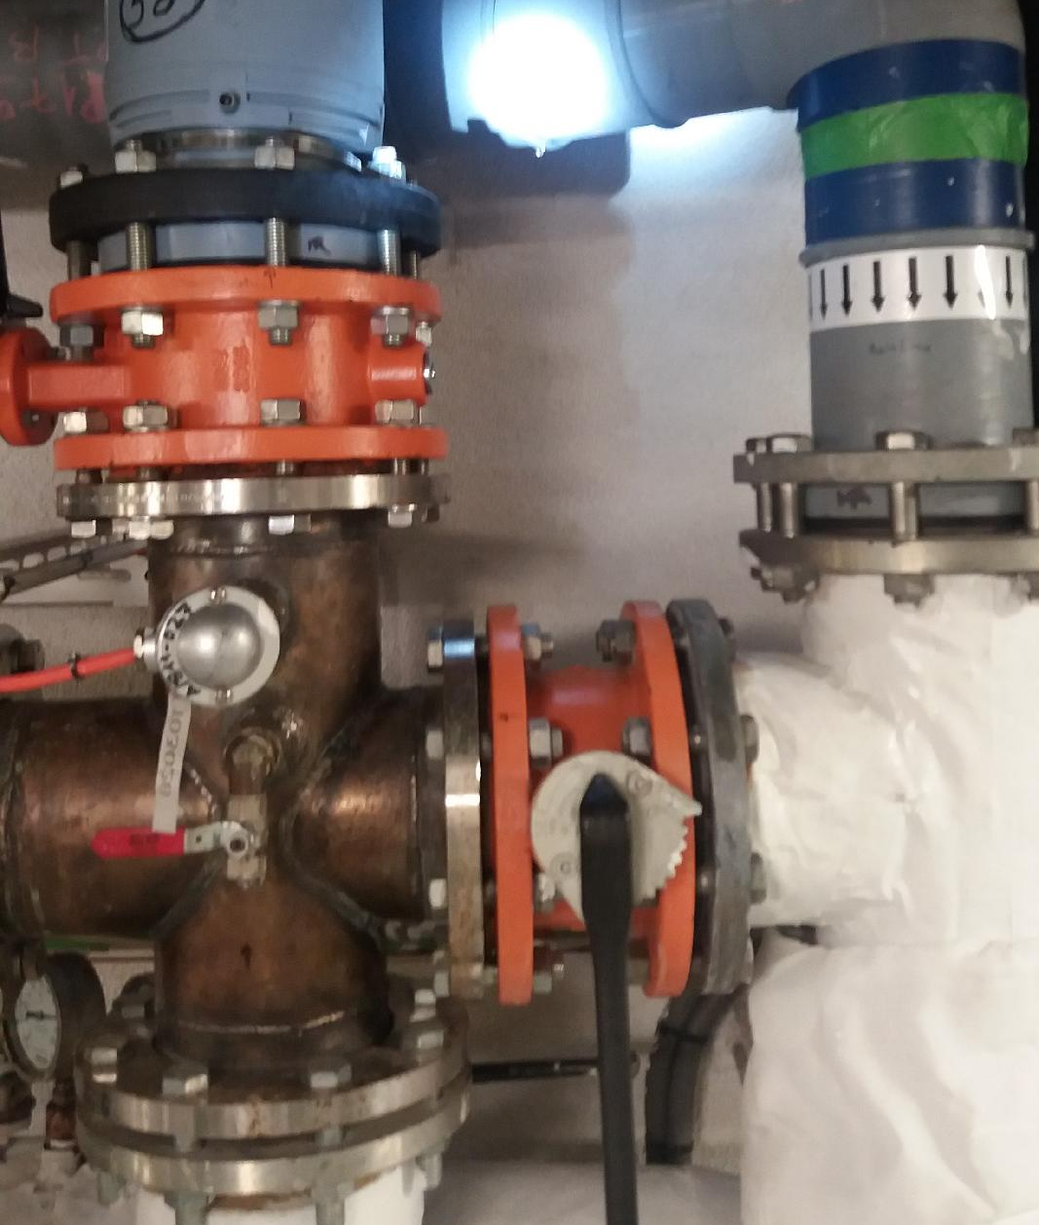
OUR WORK
Replacement existing main line for Hot and cold water in the Stabilizer room (engine room)

Slide 9
OUR WORK
hot/cold water bypasses installation on seagoing ships, without going for a dry dock,
fan coil installation,
maintenance of spa facilities,
installation of the chlorination systems.

Slide 10
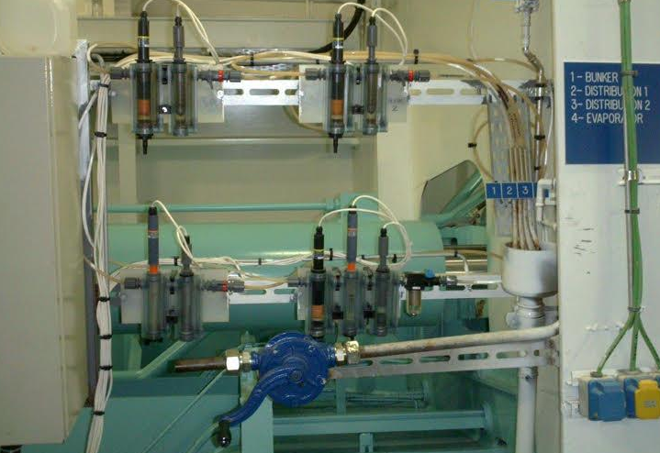
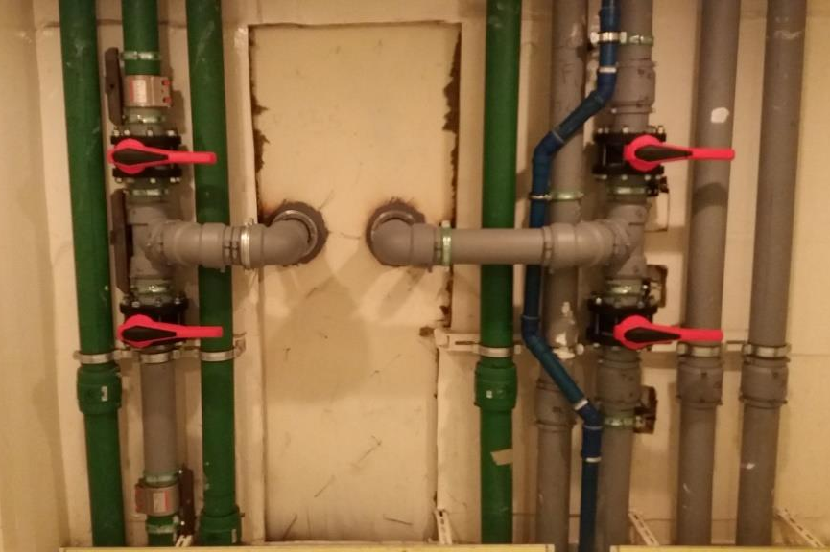
OUR WORK
Maintaining and installing chlorination system for the pool, spa, jacuzzi
Installation of hot/cold water
bypasses

Slide 11
OUR TEAM HAS 20 TECHNICIANS:
6 Certified Chief Plumbers
6 Assistant Plumbers
6 Certified Welders
1 Certified Technical supervisor
1 English speaking supervisor
During dry dock our team can expanded up to 50 technicians

Slide 12
OUR BENEFITS
G.N.I 1926
FULLY LICENSED
HIGHLY EXPERIENCED TEAM
EXCELLENT SERVICE
FULLY INSURED

Slide 13
OUR LOCATION
Our main office is located in Miami, Fl
1680 Michigan Ave, STE 700, 33139-2551
Out warehouse is located in Miami, Fl
1396 NE 125 th St, 33161

Slide 14
OUR CONTACTS
Technical Director
Infante Nunzio
+39 3386329430
Safety Manager
Infante Luigi
+39 3343532381
(786) 216-9363
www.gni1926.com
email: gni1926@yahoo.com
Skype: G.N.I 1926 Corp.

Slide 15
Thank you for watching

